Slide 1
Online Safety: Early Years and KS1
6th February 2024

Slide 2
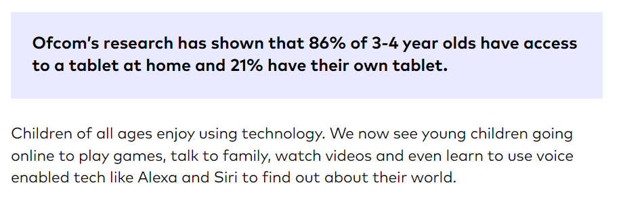

Slide 3
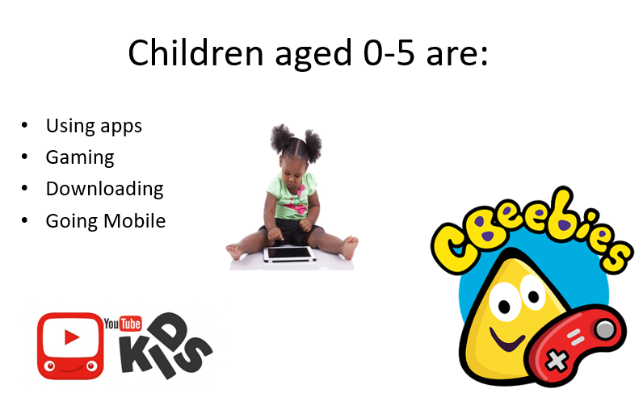

Slide 4
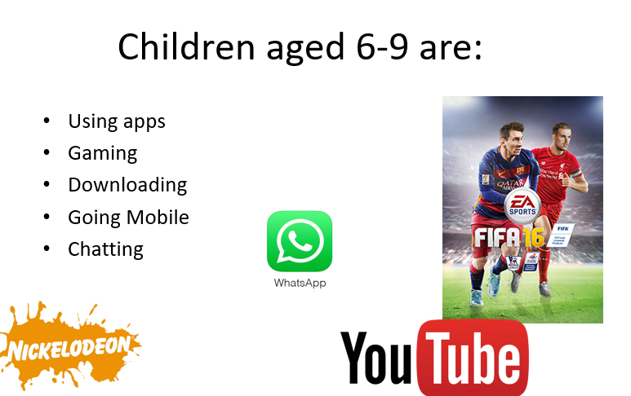

Slide 5
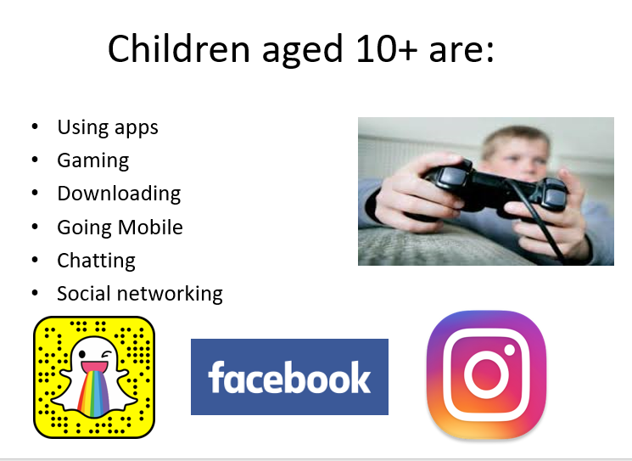

Slide 6
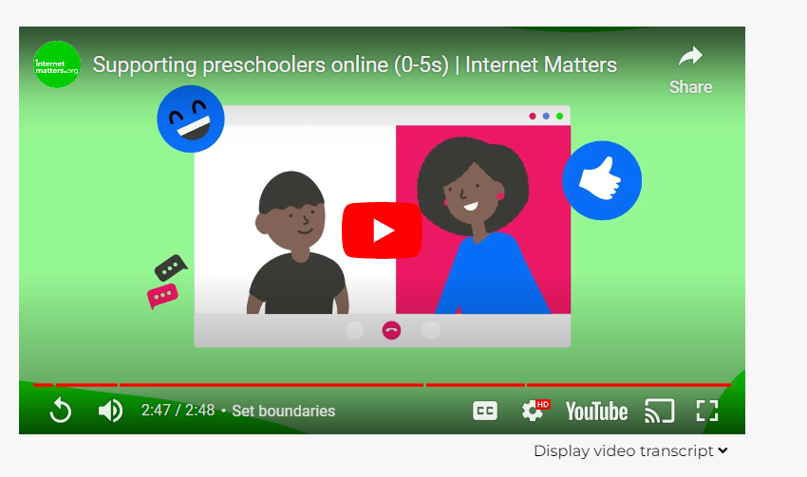
Pre-school (0-5) online safety advice | Internet Matters

Slide 7
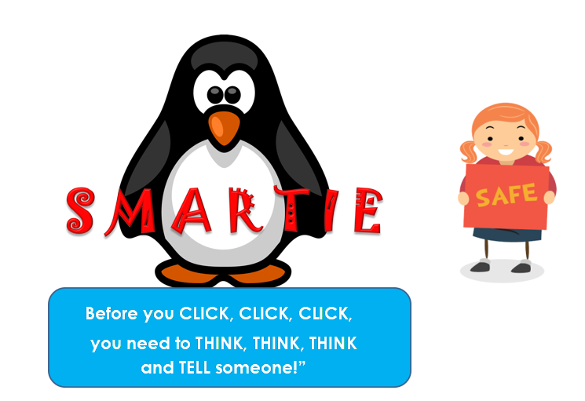

Slide 8
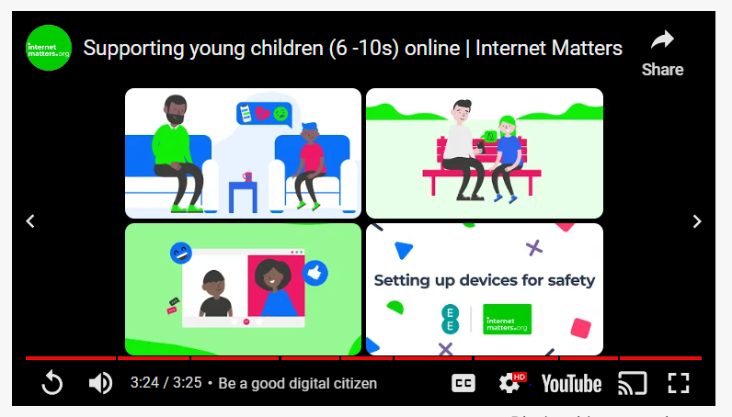
Online safety advice for 6-10 year olds | Internet Matters

Slide 9
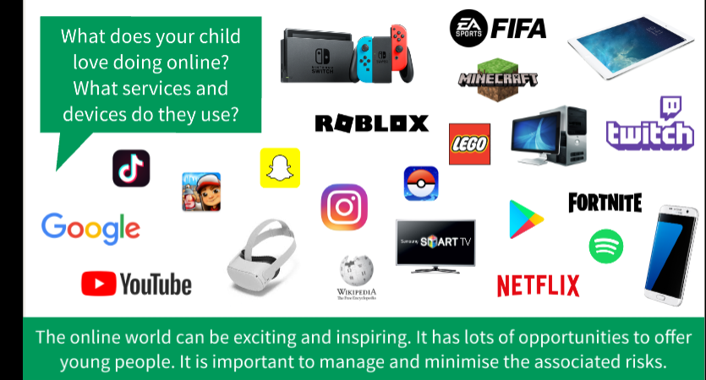

Slide 10
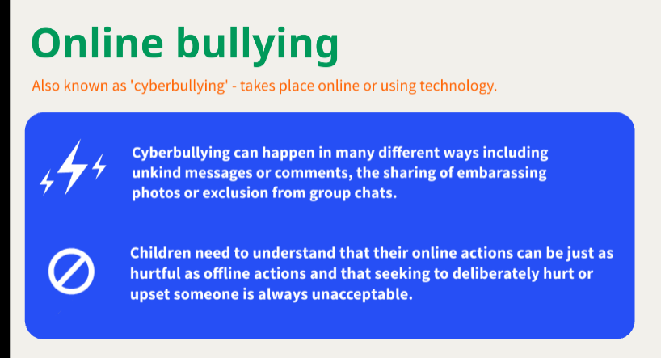
Other risks…

Slide 11
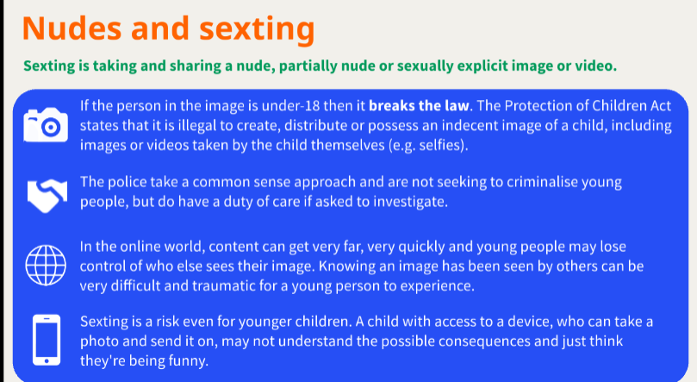

Slide 12
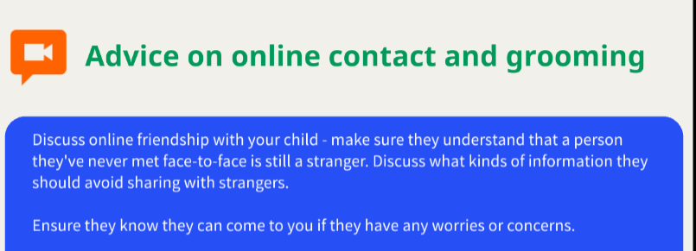

Slide 13
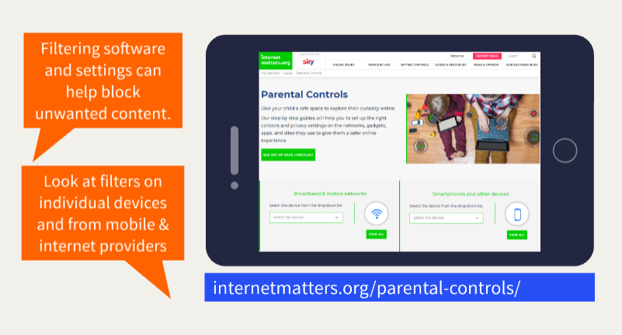

Slide 14
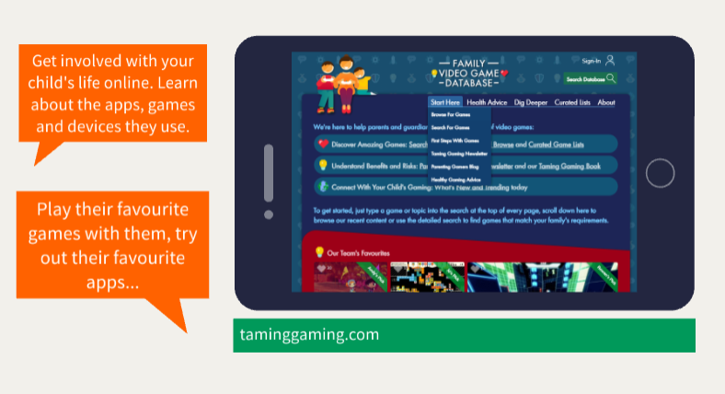

Slide 15
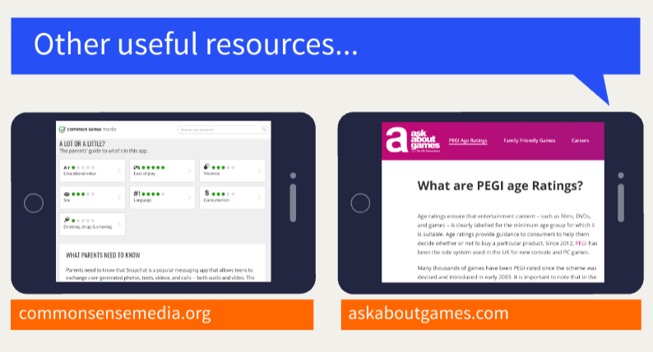

Slide 16
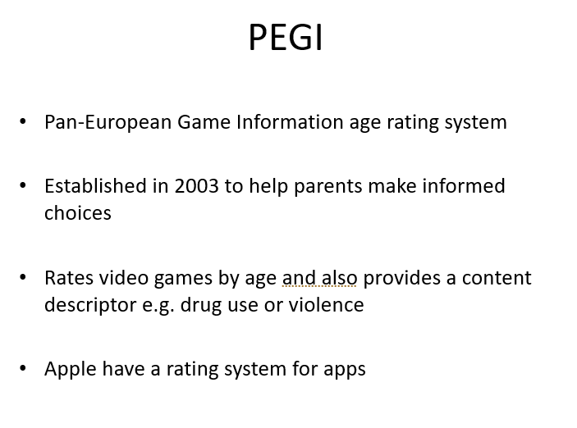

Slide 17
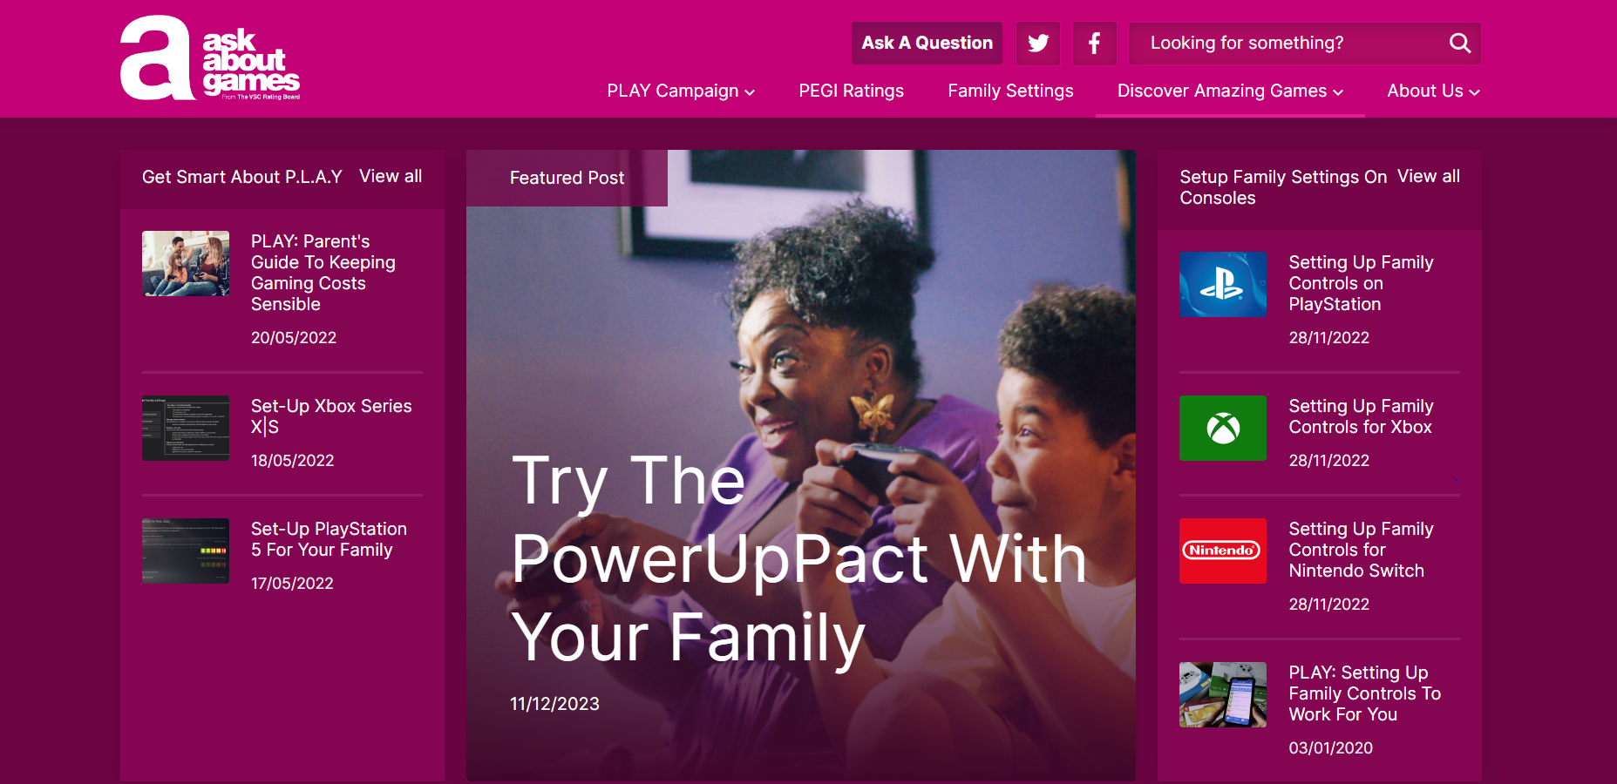

Slide 18
Screen time: time limit?
Gamer rage
-short-tempered, and more irritable as gamers. Sometimes, their gamer rage gets out of hand.
When we don’t complete a task or we fail at it, we also feel frustrated. The same thing goes for games. It’s easy to say, “It’s just a video game!” but for them, there’s still time invested. Sometimes, it’s not about whether the rage is deserved or not.
Possible strategies: Implement the “three-loss” rule.
Code word: Touch Grass- modern slang for go out and take a break when gamer rage gets the best of a player. Enables them to calm down. ‘Touch grass’ tells them that they don’t have to quit the game entirely. They just need to take a short break and give themselves space for a while.
Let them have a toy or something they can fidget with. Frustration is a form of the mind being overloaded with adrenaline. Giving your child and teen gamers a stress ball or a pen to fidget with helps them unleash their energy.

Slide 19
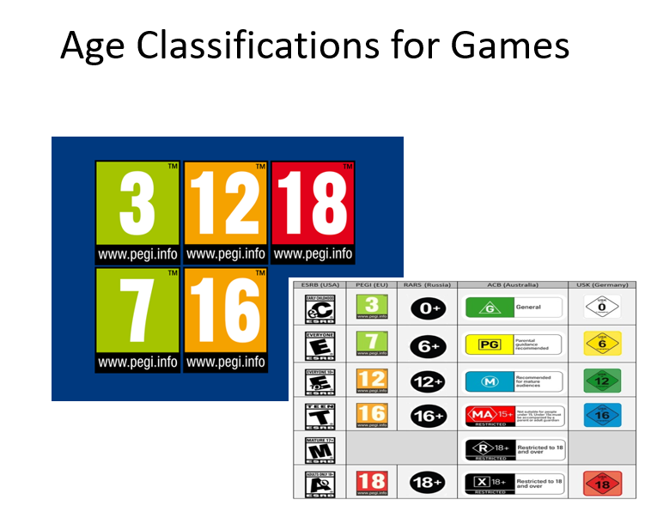

Slide 20

Contents can change when game updates.
Contents can change when game updates.

Slide 21
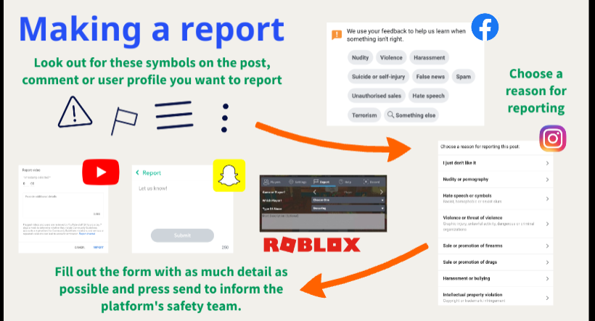

Slide 22


